Slide 1

Inversion of Control

Slide 2

Inversion of Control (IoC)
The approach of outsourcing the
construction and management of objects.
www.luv2code.com

Slide 3



Coding Scenario
getDailyWorkout()
My App
BaseballCoach
•
App should be configurable
•
Easily change the coach for another sport
•
Hockey, Cricket, Tennis, Gymnastics etc …
www.luv2code.com

Slide 4
Code Demo
•
MyApp.java: main method
•
BaseballCoach.java
•
Coach.java: interface after refactoring
•
TrackCoach.java
www.luv2code.com

Slide 5


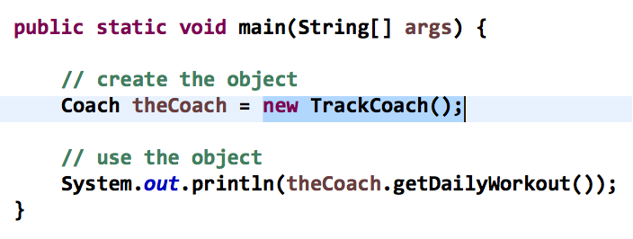



Ideal Solution
Object Factory
give me a “Coach” object
My App
configuration
BaseballCoach
CricketCoach
HockeyCoach
www.luv2code.com

Slide 6
Spring Inversion of Control

Slide 7


Ideal Solution
Object Factory
give me a “Coach” object
My App
configuration
BaseballCoach
CricketCoach
HockeyCoach
www.luv2code.com

Slide 8
Spring Container
Spring
Object Factory
give me a “Coach” object
My App
configuration
BaseballCoach
CricketCoach
HockeyCoach
www.luv2code.com

Slide 9

Spring Container
Spring
•
Primary functions
Object Factory
•
Create and manage objects (Inversion of Control)
•
Inject object’s dependencies (Dependency Injection)
www.luv2code.com

Slide 10
Configuring Spring Container
•
XML configuration file (legacy, but most legacy apps still use this)
•
Java Annotations (modern)
•
Java Source Code (modern)
www.luv2code.com

Slide 11
Spring Development Process
Step-By-Step
Configure your Spring Beans
Create a Spring Container
Retrieve Beans from Spring Container
www.luv2code.com

Slide 12

Step 1: Configure your Spring Beans
File: applicationContext.xml
<beans … >
<bean id="myCoach" class="com.luv2code.springdemo.BaseballCoach">
</bean>
</beans>
www.luv2code.com

Slide 13

Step 2: Create a Spring Container
Spring container is generically known as ApplicationContext
Specialized implementations
ClassPathXmlApplicationContext
AnnotationConfigApplicationContext
GenericWebApplicationContext
others …
Spring
Object Factory
www.luv2code.com

Slide 14

Step 2: Create a Spring Container
ClassPathXmlApplicationContext context =
new ClassPathXmlApplicationContext("applicationContext.xml");
www.luv2code.com

Slide 15



Step 3: Retrieve Beans from Container
Spring
Object Factory
give me a “Coach” object
My App
configuration
BaseballCoach
CricketCoach
HockeyCoach
www.luv2code.com

Slide 16


Step 3: Retrieve Beans from Container
// create a spring container ClassPathXmlApplicationContext context =
new ClassPathXmlApplicationContext("applicationContext.xml");
// retrieve bean from spring container
Coach theCoach = context.getBean("myCoach", Coach.class);
File: applicationContext.xml
<bean id="myCoach"
class="com.luv2code.springdemo.BaseballCoach">
</bean>
www.luv2code.com

